Slide 1
课前答疑
请准备好英语作业、课本和笔记本

Slide 2
Passage 1 1.My name is Michelle Rogers. For most of my life I had been fighting with my body weight. I was either gaining weight or trying to lose it. I wasn’t happy with myself, and I certainly wasn’t able to fully enjoy life. Not only did I feel bad physically, but I felt terrible emotionally. I also knew I wasn’t able to be the best I could be, and with failure after failure in losing weight, I just felt so hopeless to make it.
2.One day in 2008, I was looking through ads online and saw a treadmill (跑步机) for $100. This time I decided to start small and keep it doable. The first week I started walking 15 minutes on the treadmill at a fixed time every day. The next week I did 16 minutes. Each week I added a minute. Gradually, I increased speed as well as time. Once I got to 30 minutes, the weight started dropping off.
3.I didn’t lose weight at first, but I didn’t give up like I did in the past. I realized I started feeling better. My legs were getting stronger. I didn’t feel painful like I used to when I got up from my desk. All the efforts I’d been putting into fitness made me want to start eating healthier, too. I began with small changes as well. After these years I started listening to my body. It was refusing food and habits that were bad for me. 4.Today, the extra weight is gone. I still exercise every morning. I look and feel the best I have never done. Every area of my life has improved and benefited from this change in me. Not only do I have my youthful energy, looks and health back, but also I have more confidence than I have ever had.
【答案】1．B 2．A 3．D 4．C
1．How did Michelle feel about losing weight before 2008? A．Confident. B．Hopeless /desperate/disappointed. C．Addicted. D．Annoyed. 2．How many weeks had passed before Michelle’s weight began dropping? A．15 weeks. B．20 weeks. C．25 weeks. D．30 weeks. 3．What is NOT my practice now? A．Doing exercise regularly. B．Eating healthier. C．Refusing bad food and habits. D．Gaining extra weight.
4．What can we learn from Michelle’s story? A．Time is everything.B．Interest is the best teacher.C．Start with small things. D．Nothing is more important than confidence.

Slide 3
Passage 2
1.Sport is not only physically challenging, but can also be mentally challenging. Criticism (批评) from coaches, parents and other teammates, as well as pressure to win can create too much anxiety or stress for young athletes. Stress can be physical, emotional, or psychological and research has indicated that it can lead to burnout. Burnout has been described as dropping out of or quitting an activity that was at one time enjoyable.
2.The early years of growth are important years for learning about oneself and the sport setting is one where valuable experiences can take place. Young athletes can, for example, learn how to cooperate with others, make friends, and gain other social skills that will be used throughout their lives. Coaches and parents should be aware, at all times, that their feedback to youngsters can greatly affect their children. Youngsters may take their parents and coaches’ criticisms to heart and find faults in themselves.
3.Coaches and parents should also pay attention that youth sport participation does not become work for children. The outcome of the game should not be more important than the process of learning the sport and other life lessons. In today’s youth sport setting, young athletes may be worrying more about who will win instead of enjoying themselves and the sport. Following a game, many parents and coaches focus on the outcome and find faults with youngsters’ performances. Positive support should be provided regardless of the outcome. Research indicates that positive support encourages and has a greater effect on learning than criticism. Again, criticism can create high levels of stress, which can lead to burnout.
【答案】5．B 6．C 7．A 8．C
5．What is the main idea of the first paragraph?
A．Stress should be made less. B．Sport can be mentally challenging.
C．Mental stress should be reduced. D．Sport should be made less competitive.
6．Why is sport important for young people according to the passage?
A．It enables them to criticize themselves. B．It can help them learn more about society.
C．It can provide them with valuable experiences. D．It teaches them how to set realistic goals for themselves.
7．What should parents and coaches do according to the passage?
A．Make sure children enjoy sport. B．Help children to win every game.
C．Train children to deal with stress. D．Understand the meaning of sport.

Slide 4
Passage 2
1.Sport is not only physically challenging, but can also be mentally challenging. Criticism (批评) from coaches, parents and other teammates, as well as pressure to win can create too much anxiety or stress for young athletes. Stress can be physical, emotional, or psychological and research has indicated that it can lead to burnout. Burnout has been described as dropping out of or quitting an activity that was at one time enjoyable.
2.The early years of growth are important years for learning about oneself and the sport setting is one where valuable experiences can take place. Young athletes can, for example, learn how to cooperate with others, make friends, and gain other socia1 skills that will be used throughout their lives. Coaches and parents should be aware, at all times, that their feedback to youngsters can greatly affect their children. Youngsters may take their parents and coaches’ criticisms to heart and find faults in themselves.
3.Coaches and parents should also pay attention that youth sport participation does not become work for children. The outcome of the game should not be more important than the process of learning the sport and other life lessons. In today’s youth sport setting, young athletes may be worrying more about who will win instead of enjoying themselves and the sport. Following a game, many parents and coaches focus on the outcome and find faults with youngsters’ performances. Positive support should be provided regardless of the outcome. Research indicates that positive support encourages and has a greater effect on learning than criticism. Again, criticism can create high levels of stress, which can lead to burnout.
8．What’s the author’s purpose of writing the passage?
A．To teach young athletes how to avoid burnout.
B．To persuade young children not to worry about criticism.
C．To stress the importance of encouraging children in sport.
D．To discuss the skill of combing criticism with encouragement.
【答案】5．B 6．C 7．A 8．C

Slide 5
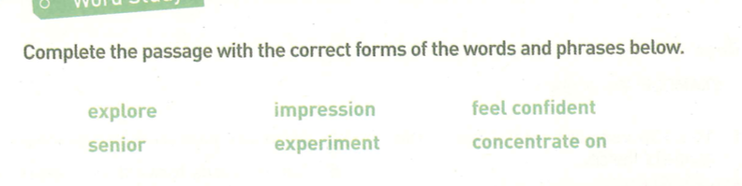
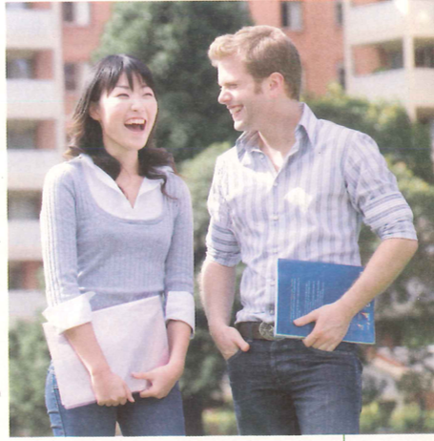
Word Study
Tian Hua is a new student at a school in America. She is studying at an American high school for one year. In China,Tian Hua was in Grade 1 at ________high school, but in America, she is in Grade 10! She did not_________________at all when she arrived. Her first__________was that English was difficult and people spoke too quickly, but soon she found that if she_________________the ideas not the single words, she could understand! She also made friends and began to__________the city with them. Her new friends were happy to explain things to her after class.Her favourite class is chemistry because the teacher lets the students do cool__________! Tian Hua is not sure how well she will do at school this year but she is not nervous any more. She is excited!
senior
feel confident
impression
concentrated on
explore
experiments

Slide 6









Language Points
In this lesson, you will be able to:
Learn some key words and phrases under the context of new school life.
Use the newly-learnt words and expressions to describe your first day of senior high school.

Slide 7
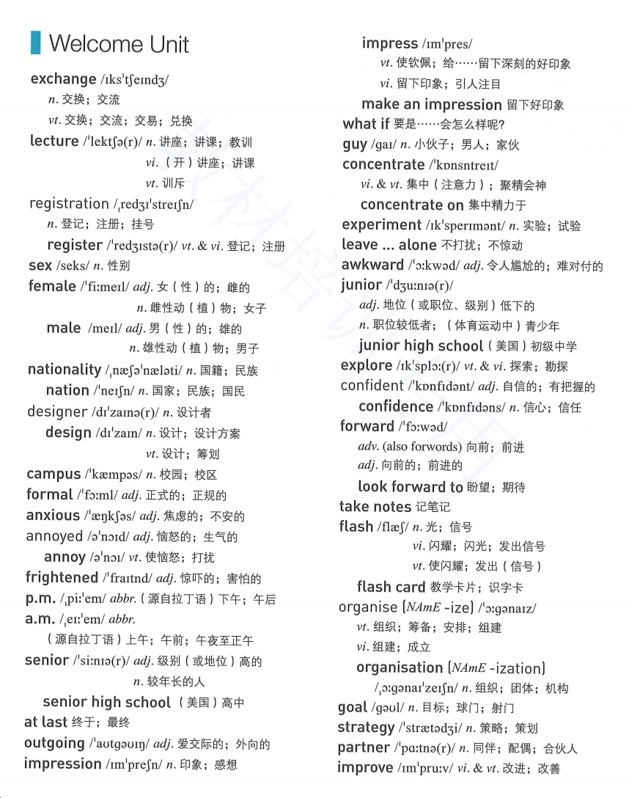

Slide 8
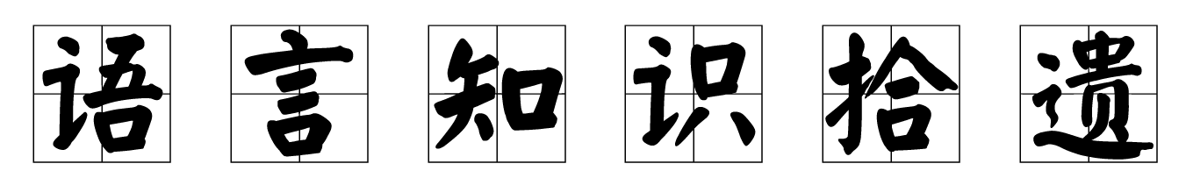
交换一个眼神？

Slide 11
It is the second time this year that our school Wushu team
_____________________________________________________!
这是我们学校武术队今年第二次与外国朋友交流经验！
It is/was+the+序数词+time that sb. has/had done sth. 某人第几次做某事
续写表达:
④ Juliet and David ___________________(相互看了看对方).
⑤I shook hands and _______________________ with the manager（……和经理相互交谈了几句）.
has exchanged experience with the foreign friends
for
for
exchanged glances
exchanged a few words

Slide 12
deliver/give a lecture
attend

Slide 13
翻译：他总是因为我的穿搭训斥我。
He always lectures me on/about my dressing way.

Slide 14
gender
national
international
注册公司/商标/学生
注册账号/号码
这辆车是以我的名字登记的。
registered
The car is registered in my name.

Slide 18


design n．设计；设计方案 vt．筹划
by design＝on purpose 有意地，故意地
designer n． 设计者
1).这项活动的目的是帮助下岗很长时间的人。
The programme is designed to help people who have been out of work for a long time．
2).据我所知，这门课是为初学者设计的。
As far as I know, the course is designed for beginners．
3). 旨在促进(promote)文化交流，民俗艺术展将于下周五在学校礼堂举行。（应用文活动类，design用法） _________________________________,the folk art exhibition is scheduled to be held in the_______________________ next Friday.
Designed to promote cultural exchanges
school lecture hall

Slide 19
on
in
n. anxiety

Slide 20
=

Slide 24
n. fright

Slide 26

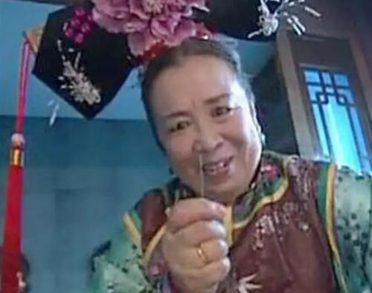
a__________(frighten) look
frightened
a__________(frighten) look
frightening

Slide 27
senior a．高级的，年长的，资深的
幼儿园
小学
初中
高中
大学
nursery school/ kindergarten
primary school
junior high school
senior high school
university/ college

Slide 28






be senior/junior to
senior a．高级的，年长的，资深的
n．长辈，上司，（初高中）毕业班学生
senior
他在一家大公司担任高级职务。
He held a _________ position in a large company.
这个年轻的学生向学长咨询英语学习。
The young student consulted his senior about English study.

Slide 32
What kind of impression did your classmates leave on you the first day of senior high school?
多种表达：
1.I was impressed by XXX the first day because…
2.XXX impressed me a lot because…
3.XXX left a deep impression on me for..
4…. was very impressive…
5.What impressed me most was/were...

Slide 33
Homework:
1.熟记语言点，准备听写 2.完成练习

